Slide 1
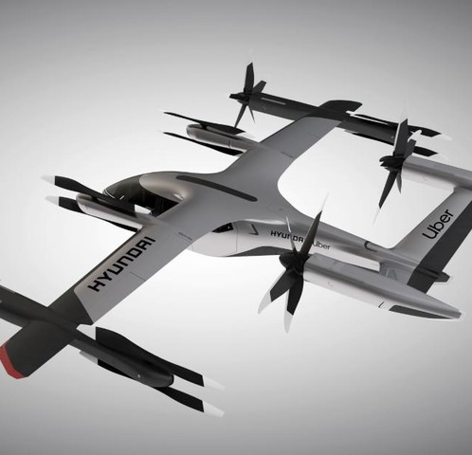
The Oracle Determining Fitness-For-Landing Probabilities
TECHNION

Slide 2

Overview: Autonomous Landing Project Objectives
Find a safe landing place for a drone in a crowded urban environment
Do it fast
Prevent collisions
Provide performance guarantees (False positive/ False Negative)
Implement and test in a simulation (phase 1) and a live demo (phase 2)

Slide 3
The Oracle within the system
Pre-processing
Pub
Sub
Sub
Sub
Sub
Sub
Depth Camera
Pub
Sub
Pub
Detection and Tracking
Oracle
GPS/INS
Pub
Pub
Sub
Sub
Pub
Pub
Pub
Pub
LIDAR
Pub
Sub
Sub
Pub
Decision Making
Sub
Sub
Sub
Pub
Vis Camera
Sub
Sub
Sub
Pub
Sub
3D Map Database
Local Trajectory Planner
Global Path Planner
Pub
Sub
Vis Camera
Sub
Pub
Pub
Sub

Slide 4
The Oracle within the system
Extracting information from input images for the other modules to use

Slide 5

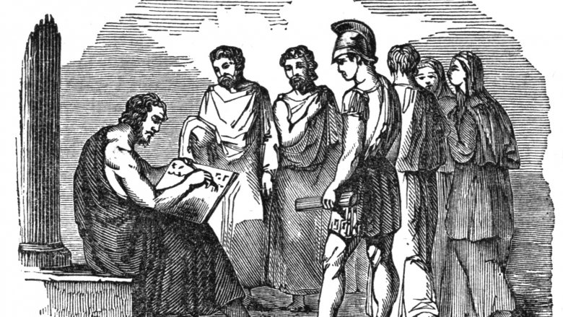

Oracle Objective
Given a single image of an urban environment
Calculate for each pixel of the image its suitability for being part of a landing spot
Suitability is measured in the probability sense: the closer to one, the more likely it is to be appropriate
The Oracle is memoryless: assessment based on current image alone

Slide 6
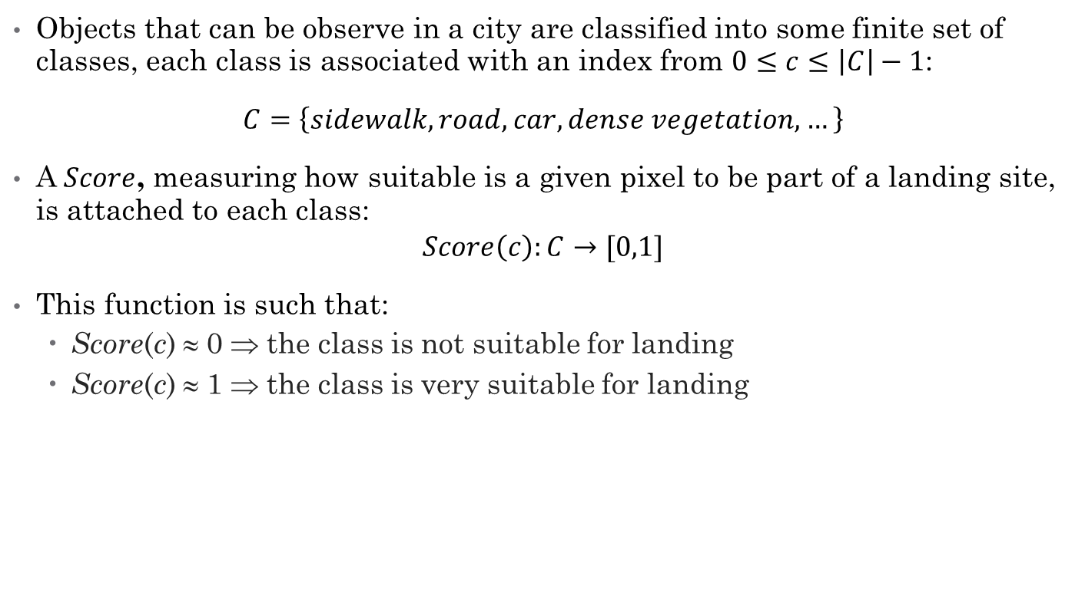
Landing Site Fitness as a Classification Problem
Objects that can be observe in a city are classified into some finite set of classes, each class is associated with an index from $0≤c≤\left|C\right|−1$:
$C=\left\{sidewalk, road, car, dense vegetation,…\right\}$
A $Score$, measuring how suitable is a given pixel to be part of a landing site, is attached to each class:
$$Score\left(c\right):C→[0,1]$$
This function is such that:
Score(c) ≈ 0 ⇒ the class is not suitable for landing
Score(c) ≈ 1 ⇒ the class is very suitable for landing

Slide 7
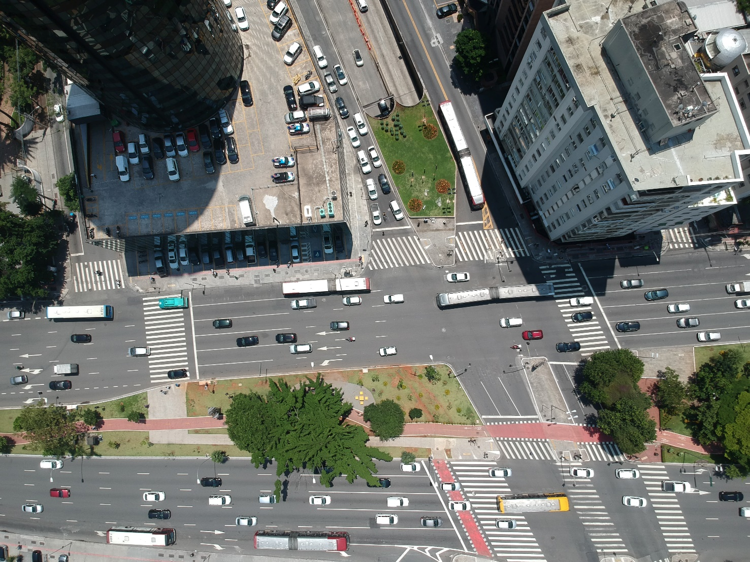
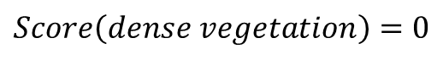
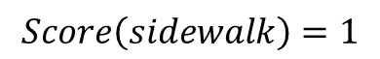
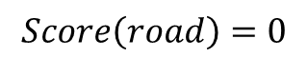
Basically, We want to land on the classes with the high scores
$$Score\left(road\right)=0$$
$$Score\left(sidewalk\right)=1$$
$$Score\left(dense vegetation\right)=0$$

Slide 8
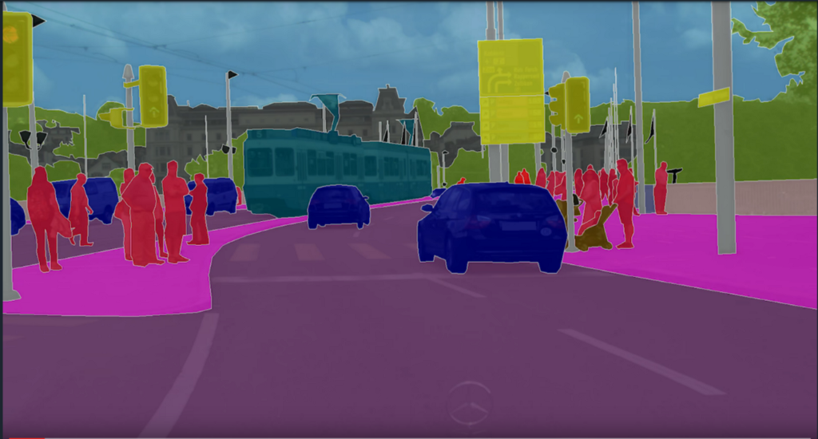
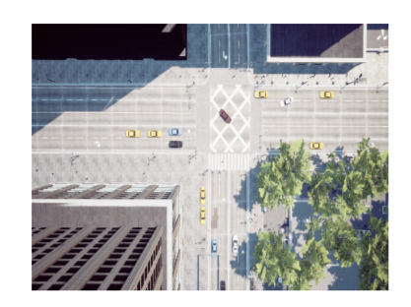
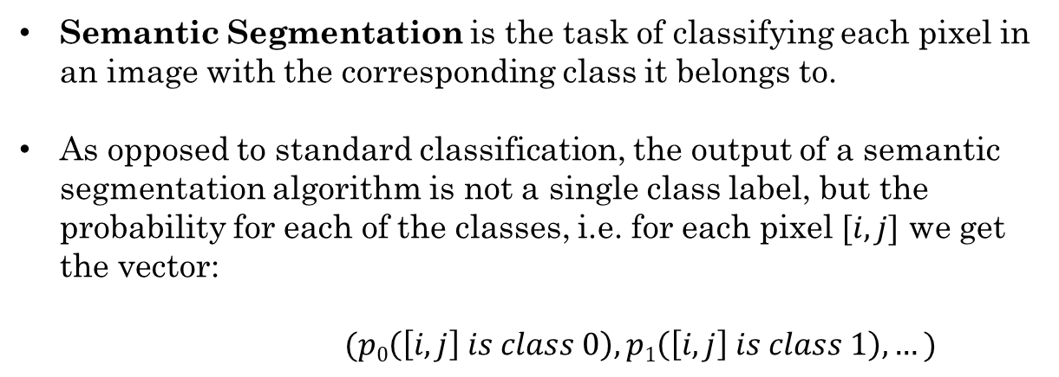
Semantic Segmentation
Semantic Segmentation is the task of classifying each pixel in an image with the corresponding class it belongs to.
As opposed to standard classification, the output of a semantic segmentation algorithm is not a single class label, but the probability for each of the classes, i.e. for each pixel $[i,j]$ we get the vector:
$$(p0\left(\left[i,j\right] is class 0\right), p1\left(\left[i,j\right] is class 1\right), …)$$
C
Model
H
Class 2
Class C
Class 1
W

Slide 9
Selected Algorithms
An extensive literature review was performed
Two different semantic segmentation algorithms were found to be adequate to solve the fitness problem, due to their relative high performance and low runtime:
Bilateral Segmentation Network for Real-time Semantic Segmentation
Fast Semantic Segmentation Network
These two algorithms are briefly reviewed next

Slide 10
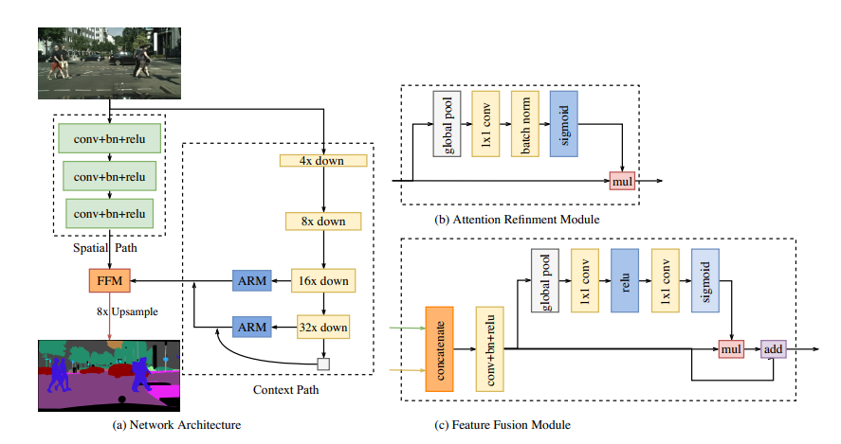
BiSeNet: Bilateral Segmentation Network for Real-time Semantic Segmentation
This model containing 2 paths - one with spatial information, where each convolution is affected by a small number of inputs, and with moderate down sampling, and a context path, with aggressive down sampling. Then they fuse the 2 paths for the prediction.
Yu, C., Wang, J., Peng, C., Gao, C., Yu, G., & Sang, N. (2018). Bisenet: Bilateral segmentation network for real-time semantic segmentation. In Proceedings of the European conference on computer vision (ECCV) (pp. 325-341).

Slide 11
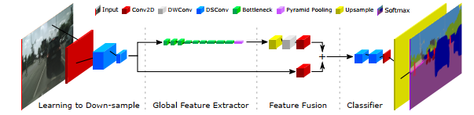
Fast-SCNN: Fast Semantic Segmentation Network
This model first down sample the image to 1:8 resolution feature map. Then using the two-branch approach. One path for feature extraction using depth wise separable convolutions and inverse residual blocks. The second path use simple convolution and then aggregated with the first path.
Poudel, R. P., Liwicki, S., & Cipolla, R. (2019). Fast-scnn: Fast semantic segmentation network. arXiv preprint arXiv:1902.04502.
Notes:
Read a little about Fast-Scnn

Slide 12
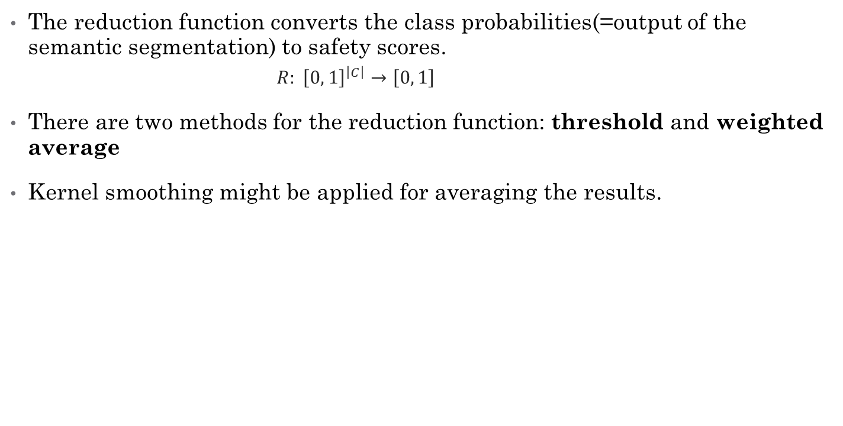
Reduction Function
The reduction function converts the class probabilities(=output of the semantic segmentation) to safety scores.
$R: {\left[0, 1\right]}^{\left|C\right|}→\left[0, 1\right]$
There are two methods for the reduction function: threshold and weighted average
Kernel smoothing might be applied for averaging the results.
C
W
W
Reduction Function
H
H
Class 2
Class C
Class 1
Landing Zone Scores

Slide 13
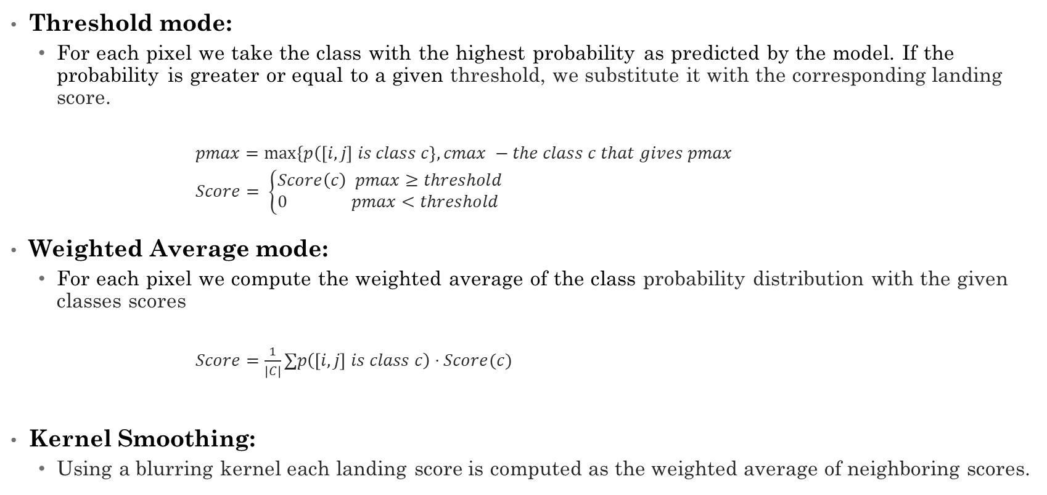
Reduction Function
Threshold mode:
For each pixel we take the class with the highest probability as predicted by the model. If the probability is greater or equal to a given threshold, we substitute it with the corresponding landing score.
$pmax=max⁡\{p\left(\left[i,j\right] is class c\right\}, cmax −the class c that gives pmax$
$Score= \left\{\begin{matrix}Score\left(c\right) pmax≥threshold \\ 0 pmax<threshold \end{matrix}\right.$
Weighted Average mode:
For each pixel we compute the weighted average of the class probability distribution with the given classes scores
$Score=\frac{1}{\left|C\right|}∑p\left(\left[i,j\right] is class c\right)⋅Score(c)$
Kernel Smoothing:
Using a blurring kernel each landing score is computed as the weighted average of neighboring scores.

Slide 14


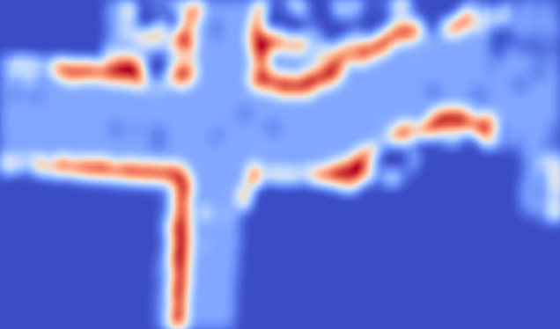
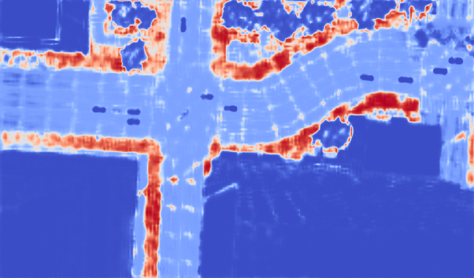
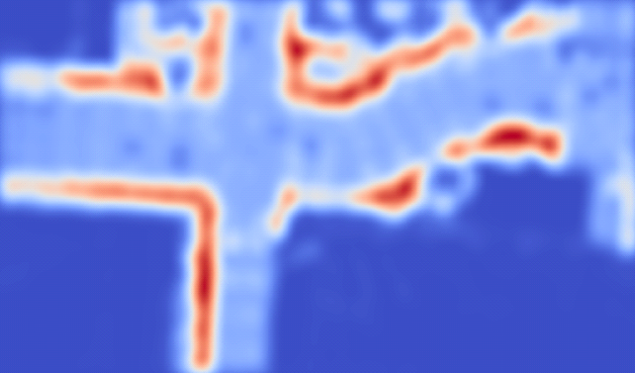
Reduction Function
Input Image
Reduction
Smoothing
Thres
hold
Weighted
Average

Slide 15
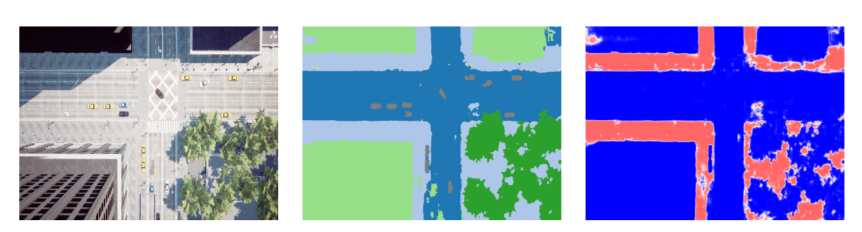
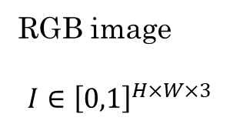
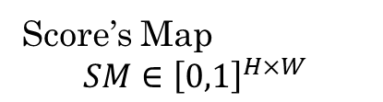
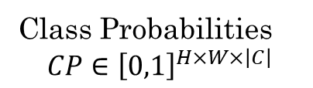
Decision Making Module
Uses this information and other data to select a landing site
Semantic Segmentation
Reduction To Scores
RGB image
$$I∈{\left[0,1\right]}^{H×W×3}$$
Class Probabilities
$$CP∈{\left[0,1\right]}^{H×W×\left|C\right|}$$
Score’s Map
$$SM∈{\left[0,1\right]}^{H×W}$$
Downward Facing Camera

Slide 16

Experiments & Results

Slide 17
Experiment Setting:
Dataset
Created using AirSim on top of Unreal Engine
Contains image and full pixel-wise labeling for each image
Size of the training set is 995 images
Size of the test set is 438 images
Hardware
Single CPU - Xeon(R) CPU E5-2683 v4 @ 2.10GHz
Single GPU - GeForce RTX 2080
Software
Linux(Ubuntu)
Python 3.8
Pytorch 1.5
Notes:
Add here image dimensions

Slide 18
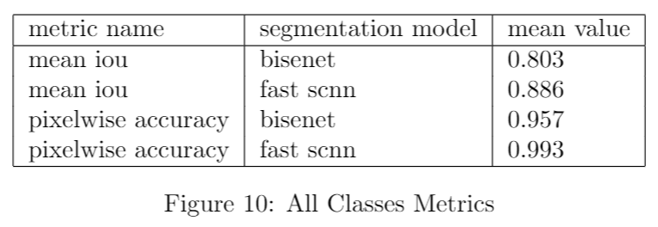
Semantic Segmentation Correctness:
Notes:
Maybe add here definition of IoU and Accuracy

Slide 19
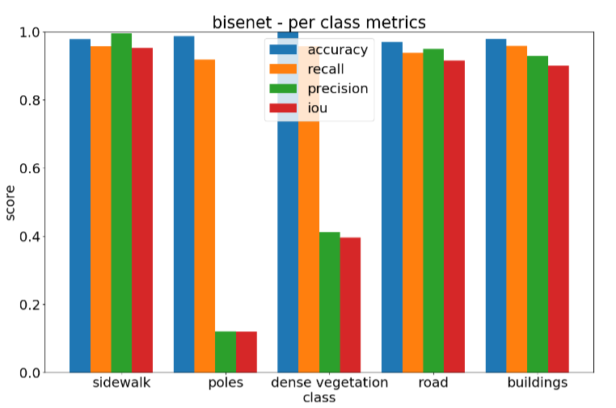
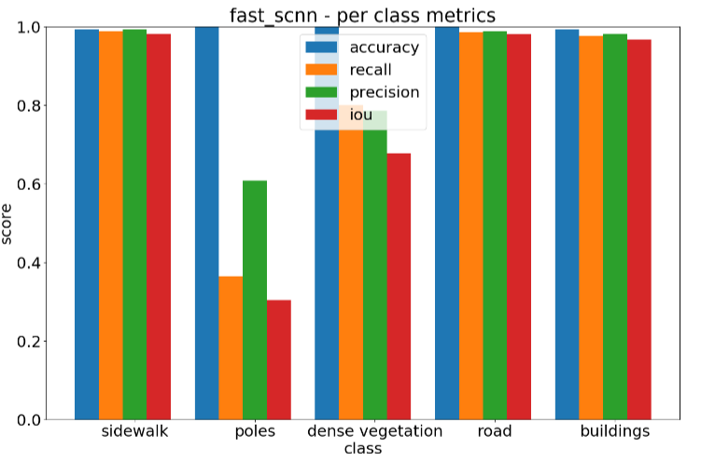

Slide 20
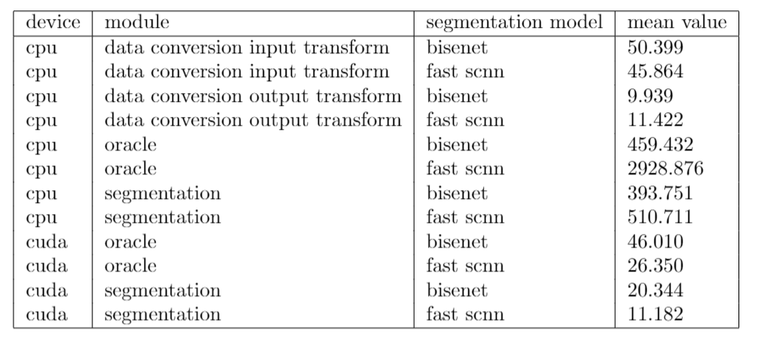
Runtime Speeds (in m.s.):
Total time = (cpu input + output conversion) + (cuda oracle time)
Fast-SCNN: (46 + 12) + (26) = 84ms = 11 FPS
BiSeNet: (50 + 10) + 46 = 106ms = 9FPS

Slide 21
Integration
Oracle is integrated and ready for phase 1 on the mission computer
Receives continuously images and outputs the correct output to the decision-making module

Slide 22
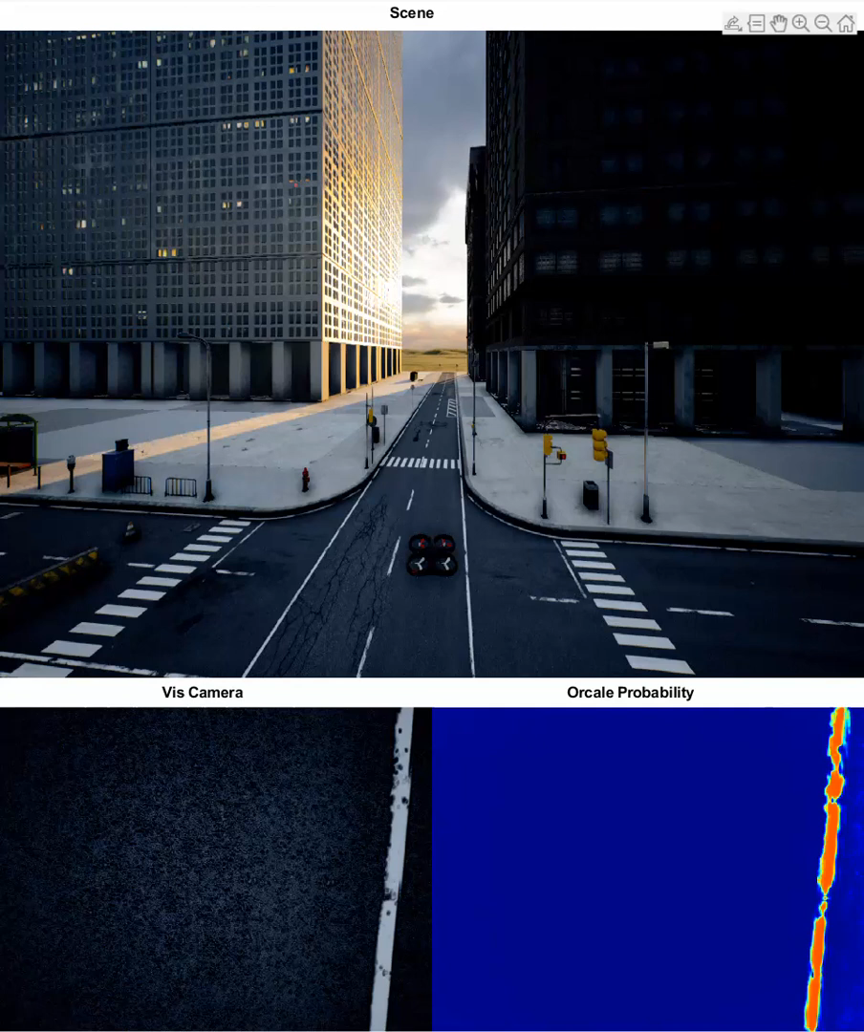

Slide 23
Conclusions
We have chosen to base the oracle on semantic segmentation, over geometric reconstruction, plane analysis.
Implemented 2 segmentation models, and both achieved good results on the simulated dataset.
Got to runtime speeds of ~ 10 FPS
Kept the module simple and flexible – the mode of operation can be configured, and the definition of the landing site can be changed by modifying the set of classes and their scores.
Oracle is integrated into the mission computer

Slide 24
Future Work
Transferring from simulation to the real-world
Weak Supervision - train the segmentation models based on partial labeling, for example by using image level classification labels or object bounding box annotations in the images
Transfer Learning
Synthetic Data Set Augmentation: manipulating the synthetic data to look more realistic or render it with different settings to force the model learn more meaningful feature.
Fine Tunning: train the segmentation model on a large dataset and then retrain last layers on real world small dataset.
Optimizations:
Compiling model with TensorRT - TensorRT is offered by NVIDIA for optimizing deep learning models resulting lighter and faster inference time.
Software Optimization - profiling and optimizing the different parts in the module

